Slide 1

JANATA SHIKSHANA SAMITI’S SHRI MANJUNATHESHWARA INSTITUTE OF UG & PG STUDIES, VIDYAGIRI,DHARWAD-580004 2021-2022 PROJECT ON SAMSKRITI MARRIAGE HALL MAINTENANCE AND BOOKING SYSTEM By PRIYANKA S.HEGDE(19U11211) AND VIDYASHREE GAONKAR (19U11266)

Slide 2
INTRODUCTION
This is a web based application which covers all the aspects of hall maintenance and booking.
Hall maintenance and booking system manages the details of booking dates, customer, employee and payment.
This system is used to check the availability of hall . Users can easily get the information of the hall and required services. Hence there is no need to visit the place. They can book from remote place.

Slide 3
OBJECTIVE
The main objective of Samskriti hall maintenance and booking system is to manage the details of booking dates, customer, employee and payment.
To overcome the manual errors and make a computerized system.
To provide an efficient way to maintain the records.
To provide the facility for customer to book the hall and required services.
To provide the facility of online payment.

Slide 4
MODULES
Admin Module
Admin maintains the records of users who register for the website.
Maintains the records of users who have booked the event.
Maintains the records of hall and service details.
Admin can add new records, delete and edit existing records.

Slide 5
Admin can view the user payment details
Booking request made by the user can be accepted or rejected by the admin.
He can view the confirmed, rejected and paid users.
Admin views the details of the employee and can add, edit and delete worker details.
He maintains the records of the salary given to the employee.

Slide 6
User Module
The user must register for the website, once they register they should login with login credentials.
Users can edit their profile
User can get the information about:
Hall details
Services
User can make the request for the hall and required services.

Slide 7
User module continued
Before booking request is being accepted by the admin user can remove the request.
Once the request is accepted by the admin he can make the online payment
Bill is generated for the payment.
If required user can change the password

Slide 8
WORK FLOW
User or Membership user needs to register and then login to the app.
Admin will login to the app and updates all information which user can view.

Slide 9
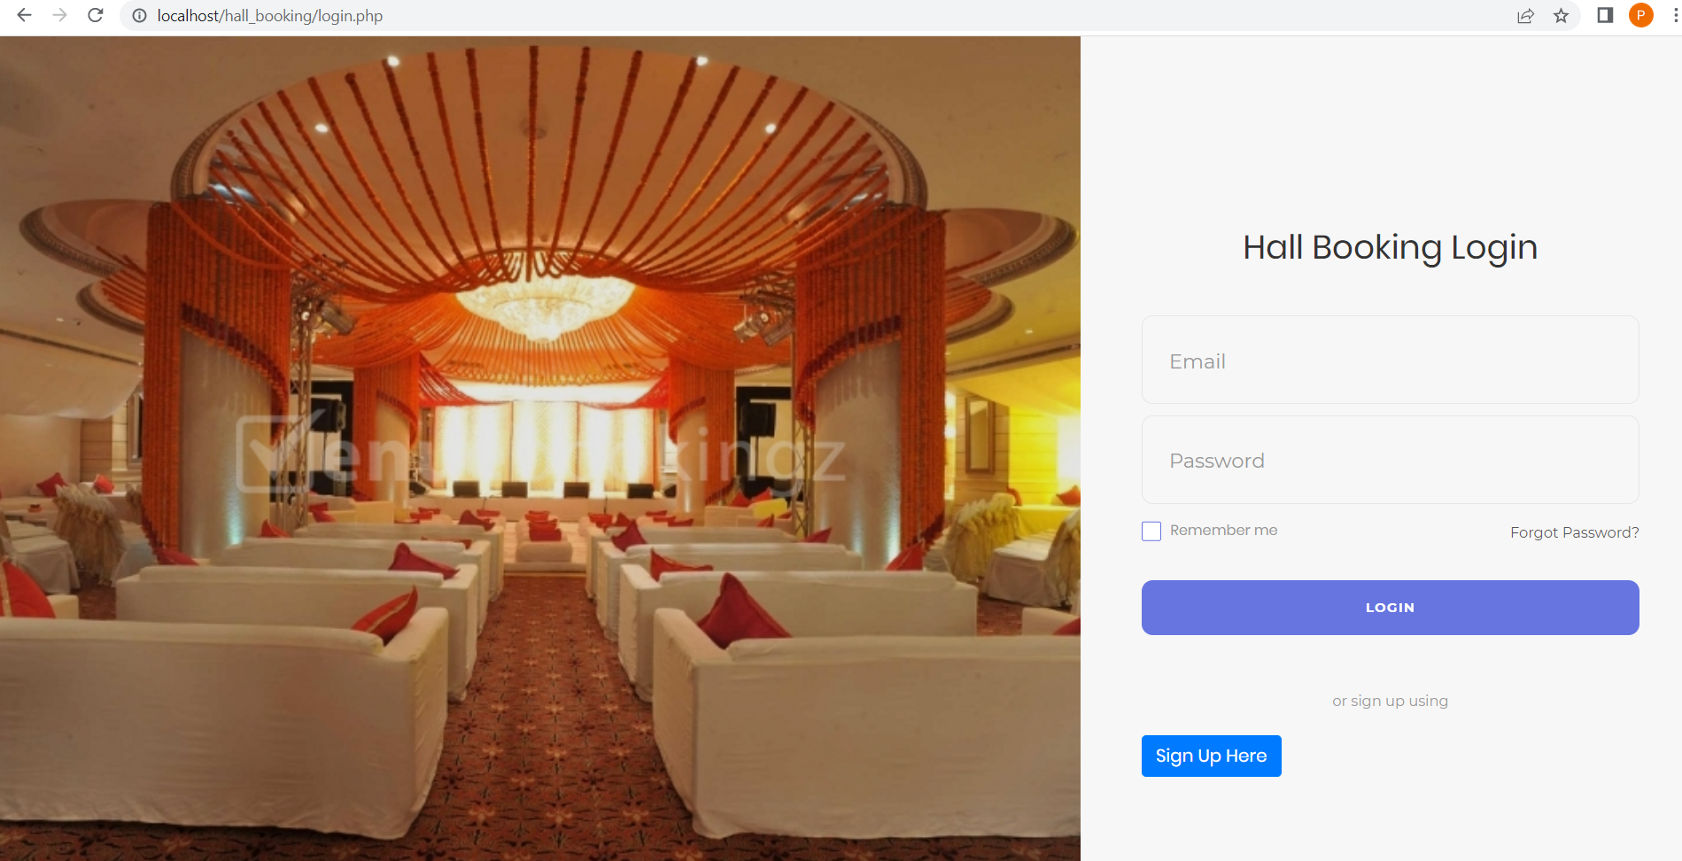
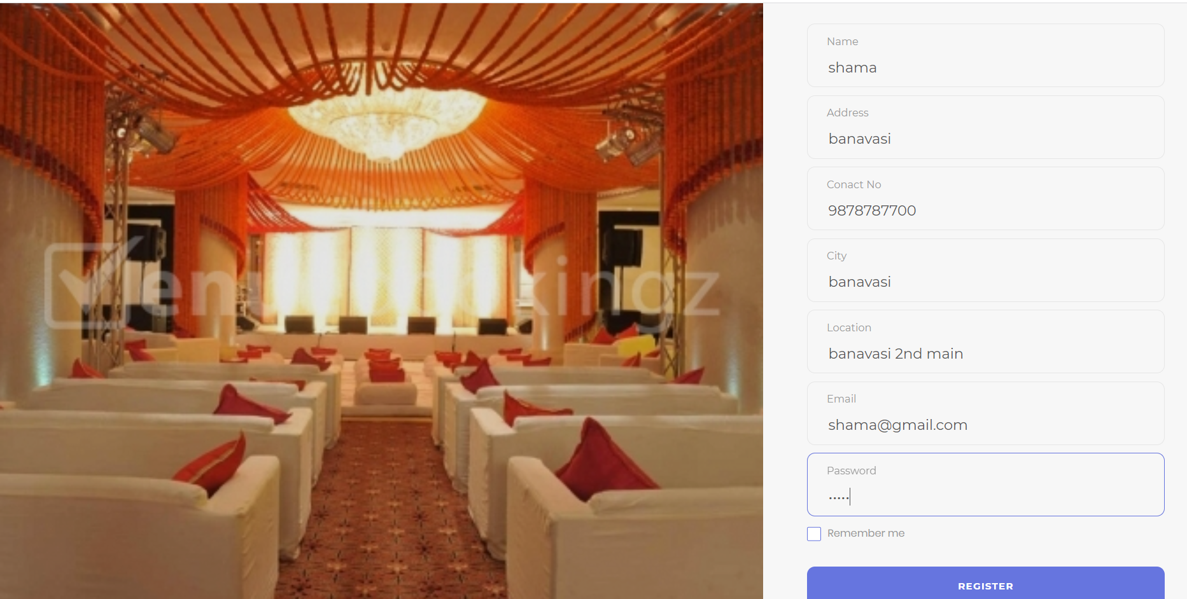
User Login Page User Registration

Slide 10
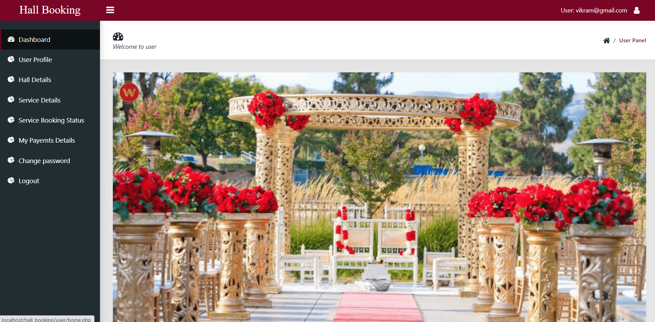
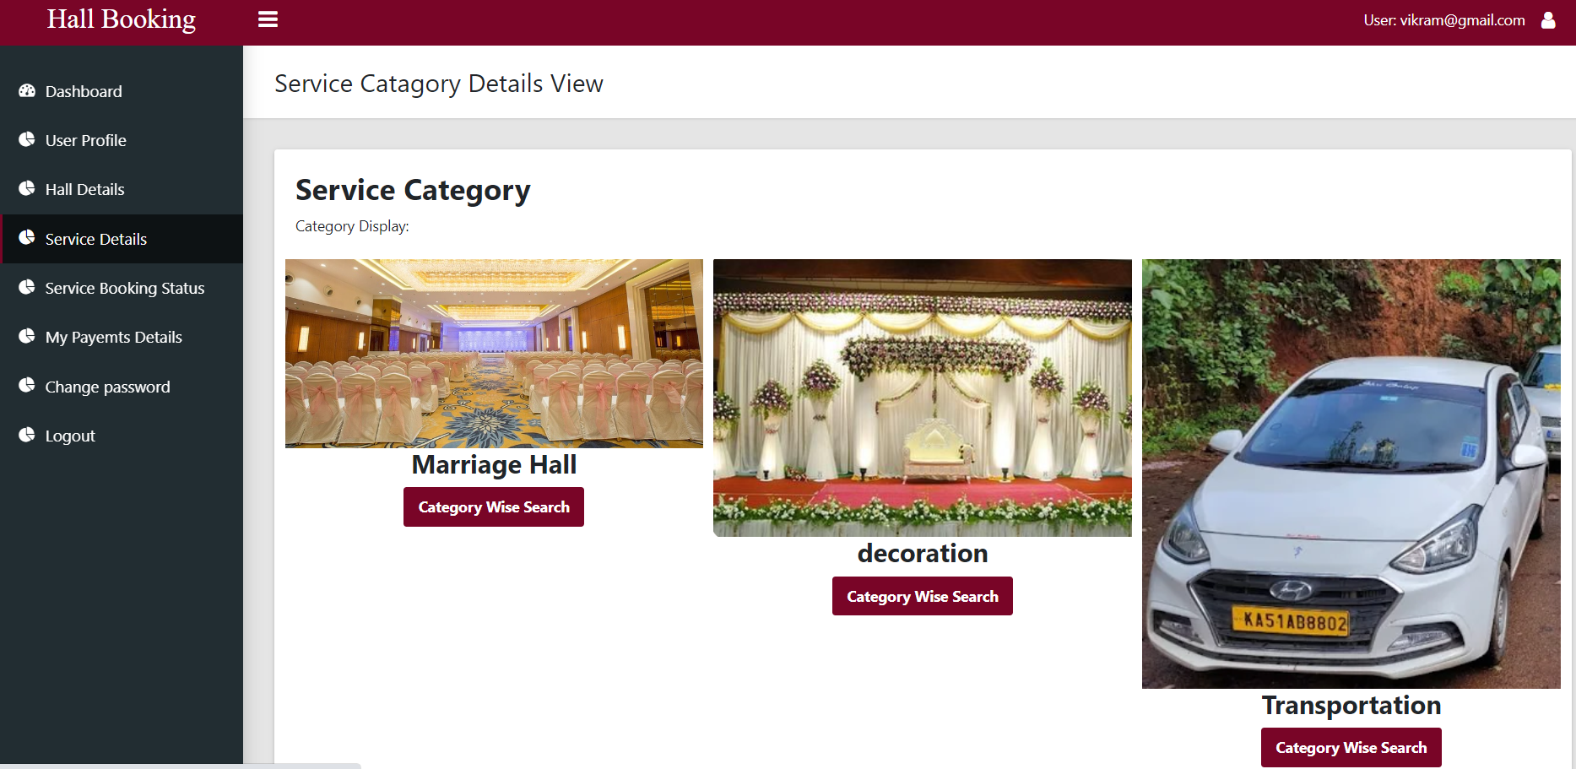
Home page Service details

Slide 11
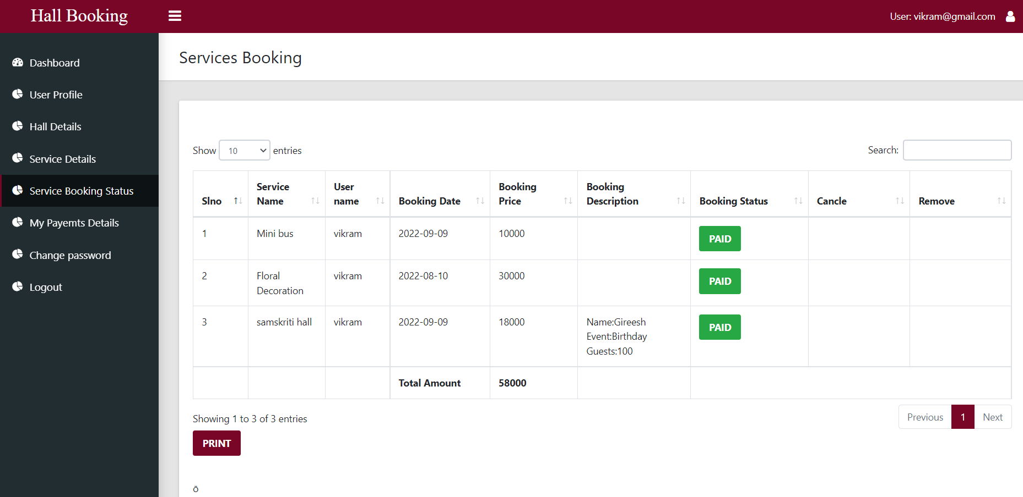

Slide 12
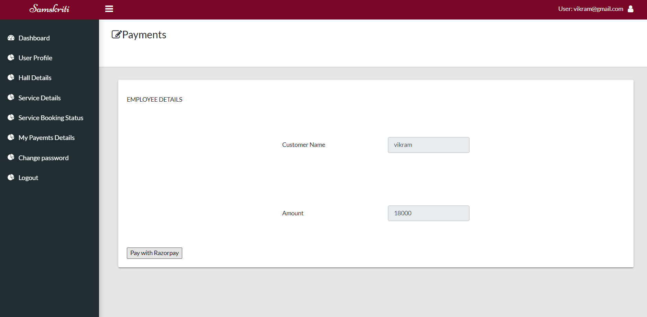
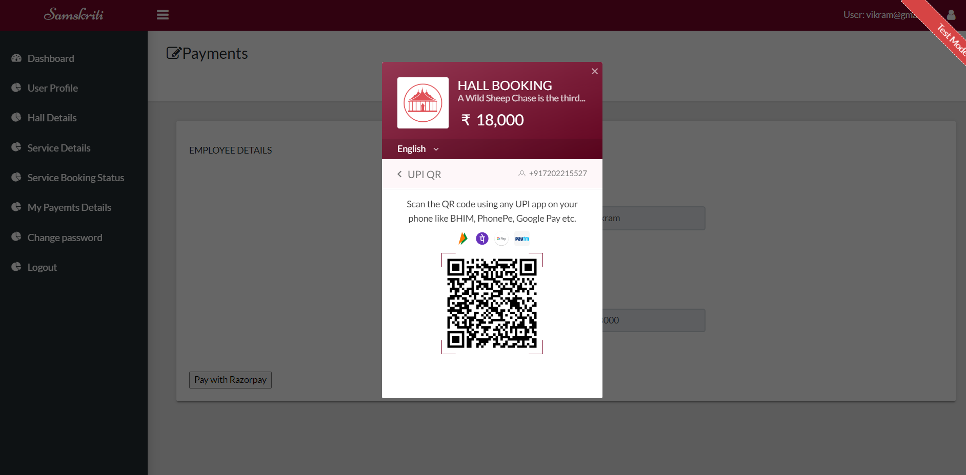
Online payment

Slide 13
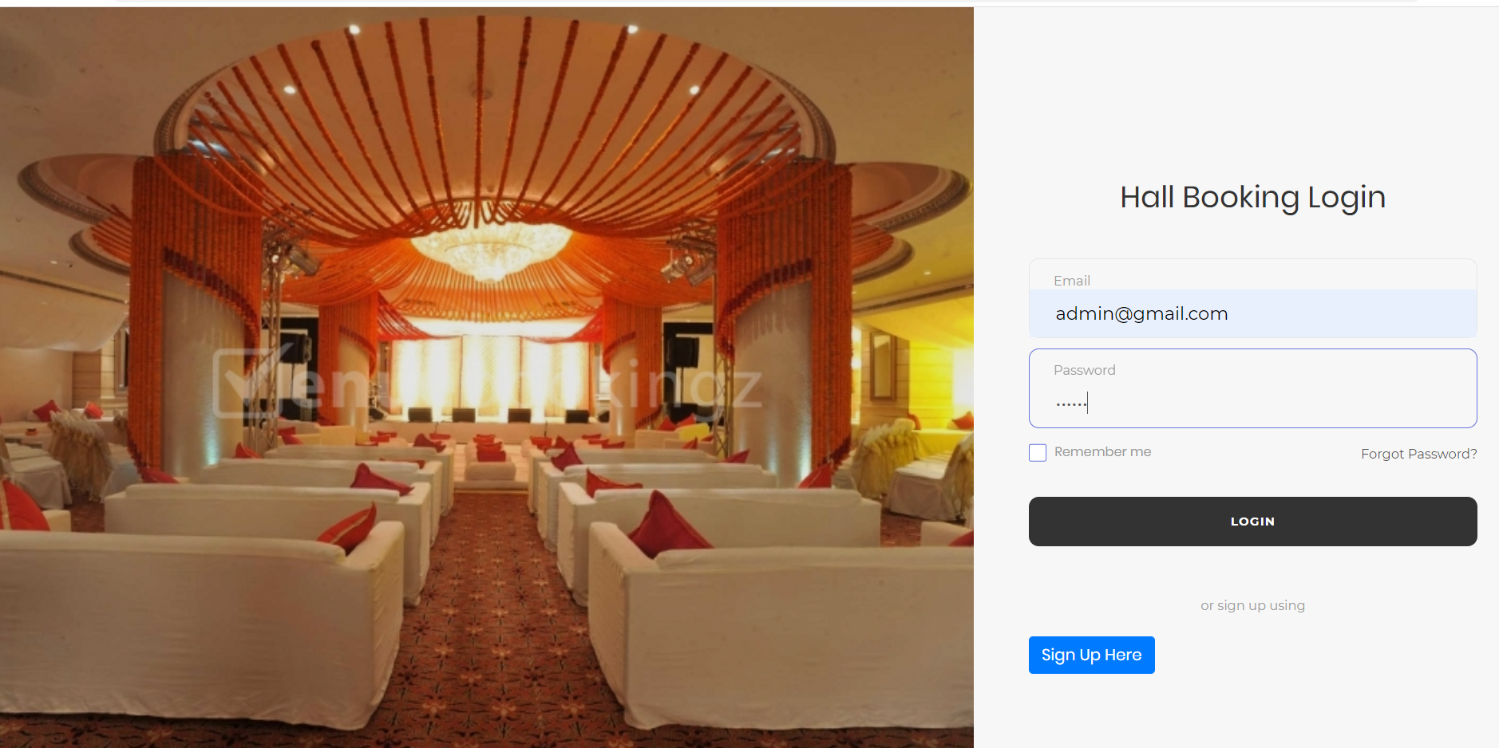
Admin login Admin home page

Slide 14
CONCLUSION
This website will help the people who are at remote place to get the information of the marriage hall and book their event.They are also provided with the facility of making online payment. Thus it saves the time of the user.

Slide 15
THANK YOU

